Slide 1
Externalities
HS201

Slide 2
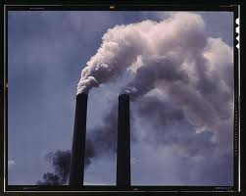
Introduction
An outcome of an economic activity which is experienced by not related third parties. Externalities may be either positive or negative.
Pollution emitted by a factory that spoils the surrounding environment and affects the health of nearby residents is an example of a negative externality.
An example of a positive externality is the effect of a well-educated labor force on the productivity of a company.

Slide 3
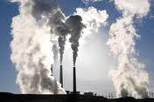

Market Failure due to Externalities
Markets can fail if there are no property rights and negotiation is costly.
The Coase Theorem: Ronald H. Coase
Market failures can be viewed as scenarios where individuals' pursuit of pure self-interest leads to results that are not efficient – that can be improved upon from the societal point-of-view.[
See the video on negative externalities on http://www.tutor2u.net/economics/revision-notes/a2-micro-externalities-overview.html

Slide 4
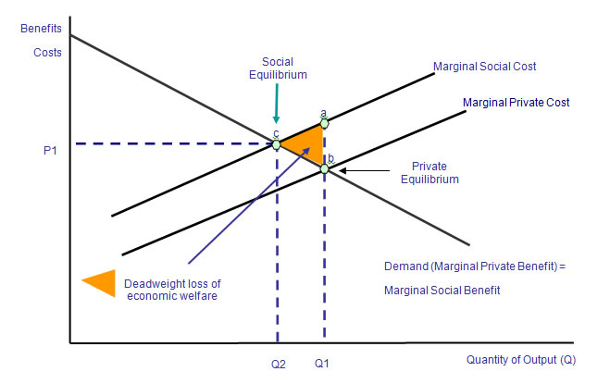
Market Failure and Externalities
In the diagram show the market failure arising from negative externalities is shown.
The area labelled ABC is the deadweight loss of welfare due to output being above the social optimum.
At output levels beyond Q2, the marginal social cost exceeds the marginal social benefit causing overall welfare to drop.
A deadweight loss is a cost to society created by market inefficiency.

Slide 5
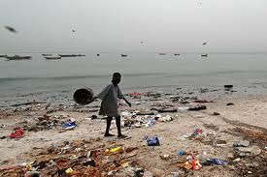
Externalities and the Tragedy of the Commons
The tragedy of the commons is a metaphor used to illustrate the potential conflict between individual self-interest of producers and consumers versus the common or public good.

Slide 6
Government Intervention
Government can ban an undesirable activity; however, this is often not socially optimal as some level of externality may be necessary to produce/consume the good (such as in the case of transportation). Society has to balance the costs and benefits of the externality.
Laws can be passed banning all production or consumption involving negative externalities and requiring production and consumption involving positive externalities.

Slide 7
Government Intervention
The government can remedy an externality by making certain behaviours either required or forbidden.
Laws can be passed banning all production or consumption involving negative externalities and requiring production and consumption involving positive externalities.
For example, the government could ban pollution and cigarette smoking and require everyone to attend school and get vaccinated.

Slide 8
Gov.. intervention
Pollution permits are advantageous when allowed into the market because it does not matter where or how these permits are distributed among firms; therefore, the initial allocation does not affect economic efficiency.
Firms that are able to lower their pollution at a low cost will sell the pollution permits they get.
The firms that lower their pollution at high costs will buy permits that they need. There has to be a free market for this to work .

